Slide 1
Lecture 1: Object Oriented Analysis and Design (OOAD)
Anna Sikharulidze
Iv.Javakhishvili Tbilisi State University

Slide 2
Objectives:
Define Object Oriented Analysis and Design (OOAD)
Show short example of OOAD
Introduce Unified Modeling Language and show how it can be used.

Slide 3
What is Analysis and Design?
Analysis emphasizes an investigation of the problem and requirements, rather than a solution. For example, if a new online trading system is desired, how will it be used? What are its functions?
"Analysis" is a broad term, best qualified, as in requirements analysis (an investigation of the requirements) or object-oriented analysis (an investigation of the domain objects).
Design emphasizes a conceptual solution (in software and hardware) that fulfills the requirements, rather than its implementation. For example, a description of a database schema and software objects. Design ideas often exclude low-level or "obvious" details obvious to the intended consumers. Ultimately, designs can be implemented, and the implementation (such as code) expresses the true and complete realized design.
As with analysis, the term is best qualified, as in object-oriented design or database design.

Slide 4
Remember:
analysis
do the right thing
design
do the thing right

Slide 5
What is Object-Oriented Analysis and Design?
During object-oriented analysis there is an emphasis on finding and describing the objects or concepts in the problem domain. For example, in the case of the flight information system, some of the concepts include Plane, Flight, and Pilot.
During object-oriented design (or simply, object design) there is an emphasis on defining software objects and how they collaborate to fulfill the requirements. For example, a Plane software object may have a tailNumber attribute and a getFlightHistory method.

Slide 6
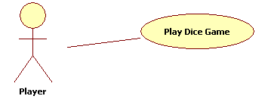
Short Example: Dice Game
Define Use Cases: Requirements analysis may include stories or scenarios of how people use the application; these can be written as use cases. Use cases are simply written stories.
Example:
Play a Dice Game: Player requests to roll the dice. System presents results: If the dice face value totals seven, player wins; otherwise, player loses.
Use Case Diagram:

Slide 7
Short Example
Define a Domain Model: Object-oriented analysis is concerned with creating a description of the domain from the perspective of objects. There is an identification of the concepts, attributes, and associations that are considered noteworthy. The result can be expressed in a domain model that shows the noteworthy domain concepts or objects.
Example: Partial domain model of the dice game

Slide 8
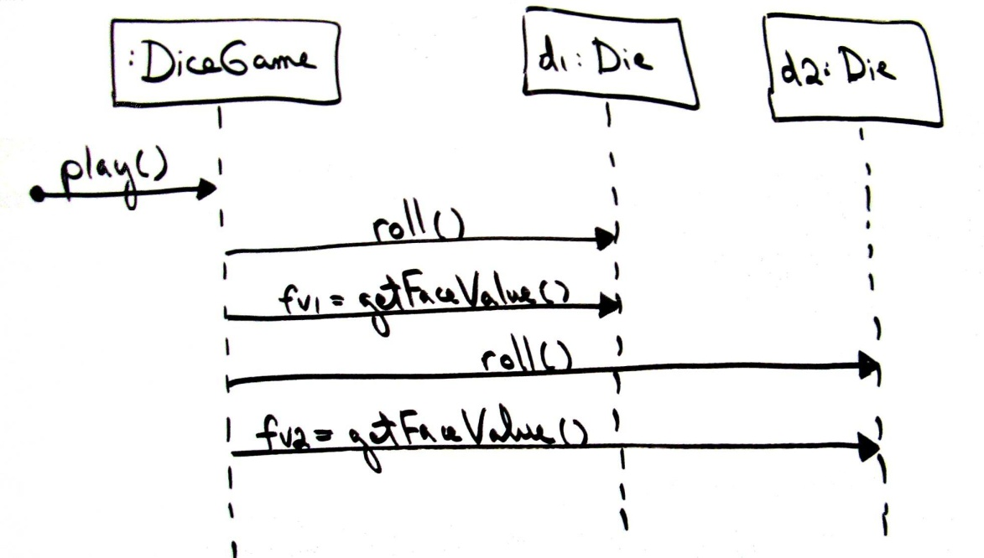
Short Example
Assign Object Responsibilities and Draw Interaction Diagrams: Object-oriented design is concerned with defining software objects, their responsibilities and collaborations. A common notation to illustrate these collaborations is the sequence diagram (a kind of UML interaction diagram). It shows the flow of messages between software objects, and thus the invocation of methods (dynamic view).
Example: Sequence diagram for the dice game

Slide 9
Short Example
Define Design Class Diagrams : In addition to a dynamic view of collaborating objects shown in interaction diagrams, a static view of the class definitions is usefully shown with a design class diagram. This illustrates the attributes and methods of the classes.
Example: Partial design class diagram for the dice game

Slide 10
The Meaning of "Class" in Different Perspectives
Class-related terms consistent with the UML and the UP:
Conceptual class: real-world concept or thing. A conceptual or essential perspective. The UP Domain Model contains conceptual classes.
Software class: a class representing a specification or implementation perspective of a software component, regardless of the process or method.
Implementation class: a class implemented in a specific OO language such as Java.

Slide 11
What is the UML?
The Unified Modeling Language is a visual language for specifying, constructing and documenting the artifacts of systems
The word visual in the definition is a key point - UML is the de facto standard diagramming notation for drawing or presenting pictures (with some text) related to software - primarily OO software.

Slide 12
Three Ways to Apply UML
UML as sketch: Informal and incomplete diagrams (often hand sketched on whiteboards) created to explore difficult parts of the problem or solution space, exploiting the power of visual languages.
UML as blueprint: Relatively detailed design diagrams used either for 1) reverse engineering to visualize and better understanding existing code in UML diagrams, or for 2) code generation (forward engineering).
UML as programming language: Complete executable specification of a software system in UML. Executable code will be automatically generated, but is not normally seen or modified by developers; one works only in the UML "programming language." This use of UML requires a practical way to diagram all behavior or logic (probably using interaction or state diagrams), and is still under development in terms of theory, tool robustness and usability.

Slide 13
Recommended Resources
For the definitive description of the current version of the UML, see the on-line UML Infrastructure Specification and UML Superstructure Specification at www.uml.org or www.omg.org.
There is a large collection of links to OOAD methods at www.cetus-links.org and www.iturls.com

